Slide 1
RELION
By Arunabh Ghosh

Slide 2
Where were we last time
In the last implementation of the Relion algorithm, no shifts were incorporated in the algorithm. Another phenomenon that could be noticed is that in some iterations, the orientations were wrongly estimated and drifted too far apart from the actual estimates.
This error in estimation lead to increase in the error function in some iterations and the accuracy of the estimated model was compromised.

Slide 3
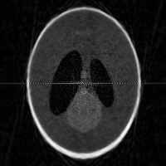
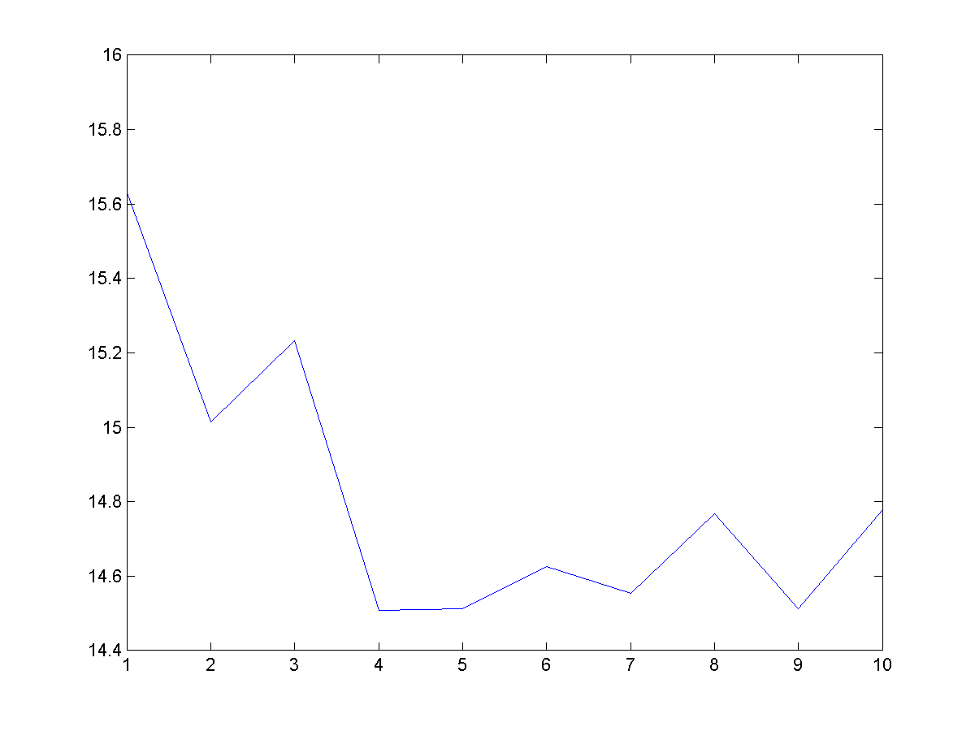
The results seen last time
Due to the phenomenon described in the previous slide, we could see results like these. Also note that there are no shifts in the projections. All the projections are perfectly aligned.
Notice that in some iterations, the error actually increased instead of steadily settling down to a constant value.

Slide 4
What changes have been made since then
The interpolation scheme and the back-projection have been improved leading to 30% less error when the image is constructed from its projections.
In the back-projection, instead of simply taking an average, of projections which have the same angles, the projections are first ordered with respect to the other projections and then equally distributed in the gap in-between. This leads to much more accurate back-projection.
The interpolation scheme, instead of simple averaging a least-square approach has been used, but the known values are not modified.

Slide 5
Other small changes
Some other small changes have been made in the parameters of the algorithm. For example, the search over all the orientations is gradually made smaller over the iterations, which leads to less chances of error and and less drift in case of wrong estimates.
Some of the other constants such as, the noise estimate, the radius of the Kaiser Bessel window has been optimized for more accurate results.

Slide 6
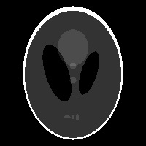

Results
This time, all the experiments have these parameters
180 projections
5 percent gaussian noise
The error in angle estimates is $±$ 5 degrees
The error in shift estimates is $±$ 2 pixels
This is the original image -

Slide 7
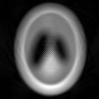
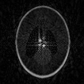
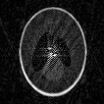
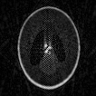
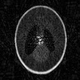
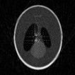
Results

Slide 8
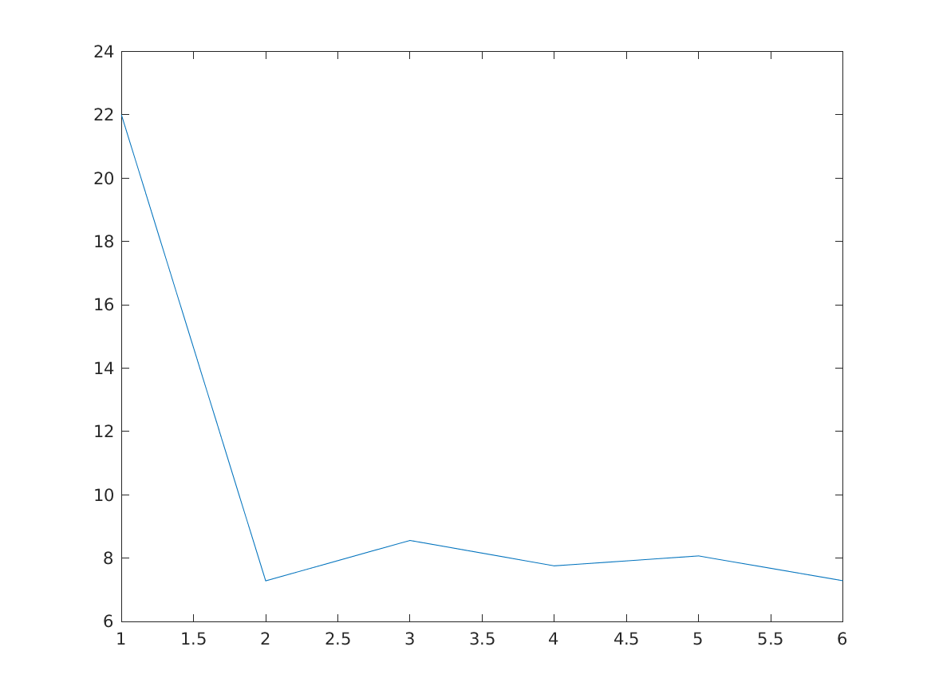
Results
As we can see, the error constantly decreases upto a point and then maintains itself and is fairly constant over a period of time. This is inspite of having such bad starting model which has shift errors as well as orientation errors.

Slide 9
Other work done
The program generally took about 45 mins to 30 mins to run, and in that time I decided to look at what are the other algorithms that are used for this purpose that have been recently developed.
I came across CryoSPARC which has been recently developed and is giving serious competition to RELION. The main paper again lacked mathematical details, so after looking at the source code documentation and other supplementary documents, I have prepared a brief summary of the algorithm complete with mathematical details.
Also I have compared the advantages and disadvantages of this algorithm compared to the relion algorithm.

Slide 10
Future work
Over the coming week, the mathematics of the new priors will be worked out, and experiments will be run to see if we can impose stronger priors on the Fourier coefficients as the iterations progress.
Also, I’ll try to extend the algorithm to detect heterogenous structures, and make the algorithm identify which projection belongs to which projection.

